Slide 1
Under & Over Fitting

Slide 2
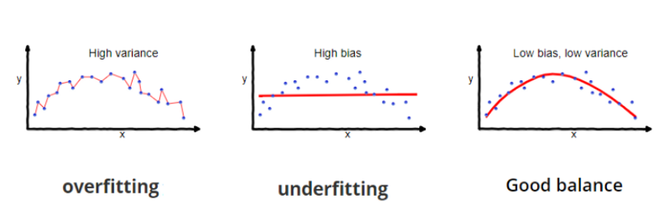
Under and Over fitting Example

Slide 3
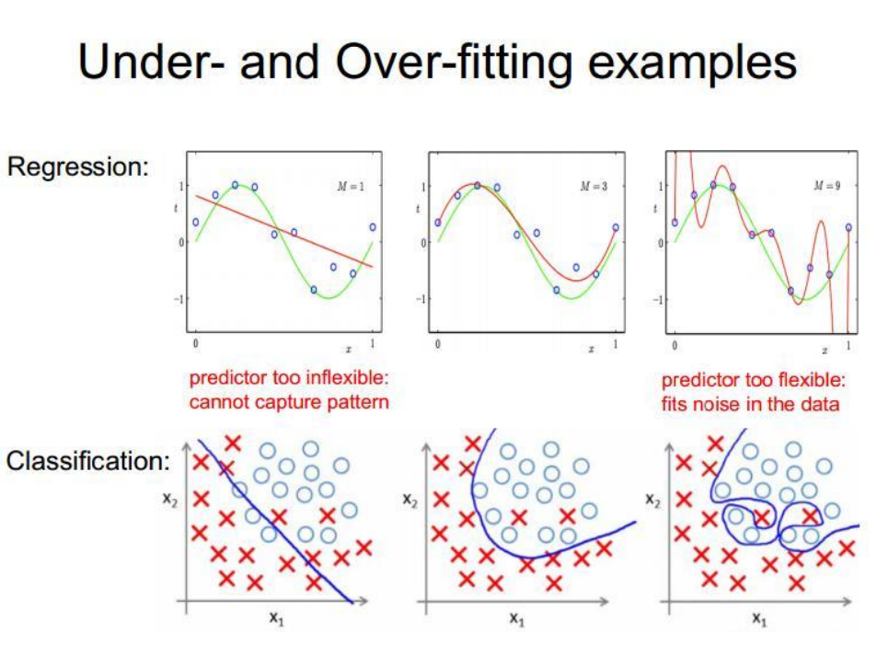

Slide 4
Bias and Variance
Bias Error
Bias are the simplifying assumptions made by a model to make the target function easier to learn.
Variance Error
Variance is the amount that the estimate of the target function will change if different training data was used.
Eg:
The k-nearest neighbors algorithm has low bias and high variance
The support vector machine algorithm has low bias and high variance

Slide 5
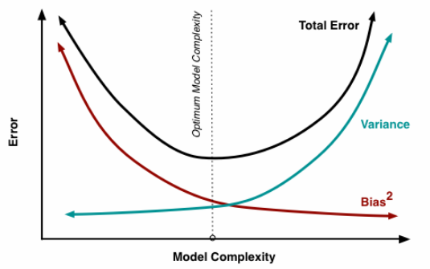
Training error and generalization error – Bias and Variance

